Slide 1

REIsE CAR
Project on web development
ONILINE CAR POOLING SYSTEM
By: GROUP 5
AASTHA
PRASHANT
CHIRAG
PRAKHAR

Slide 2
Contents
REISE CAR
HOW REISE CAR FUNCTIONS
WHAT HAVE WE USED
FRONT END
BACK END

Slide 3

What is Reise Car?
It is a website which helps us in finding people around us willing to share their ride with unknown people in other words (Car pool).
The unknown riders has to pay some amount of money according to the distance.
You get to meet new people.
You get to make new connections.
It helps the car owner earn some extra money

Slide 4

How Reise Car functions…
The car user as well as car owner have to make accounts on the website.
Then the person has two choices whether to offer a ride or search for a ride.
To offer a ride he has to put in his details as well as his/her cars details and his/her travelling details
To search for a ride the riders has to put his/her travelling details like time of travel, date of travel, destination etc.
Then finally booking the required ride.

Slide 5

Reise Car has→
Signup
Login
Search for ride
Offer a ride

Slide 6
What have we used?
HTML
JSP
BOOTSTRAP
CSS
JAVA
JDBC
SERVLET
SQL
TOMCAT
MAVEN

Slide 7
FRONT END
HTML, CSS, BOOTSTRAP is used to design the front end of the website.
HTML gives basic structure to the website.
CSS and BOOTSTRAP gives it some design to make it look good.
JSP is used to connect to code the java part as well the html part together which helps us make things easy for us

Slide 8
FRONT END
http://localhost:8080/ReiseCar/index1.html

Slide 9
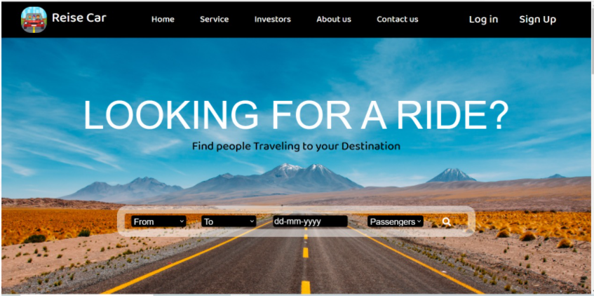
MAIN PAGE

Slide 10
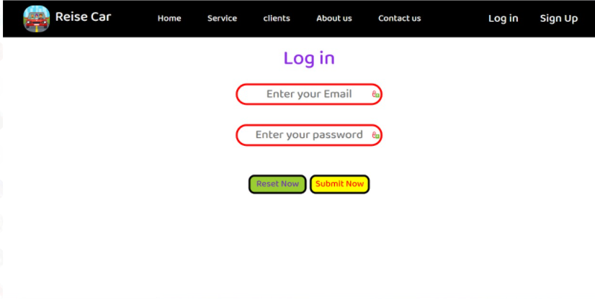
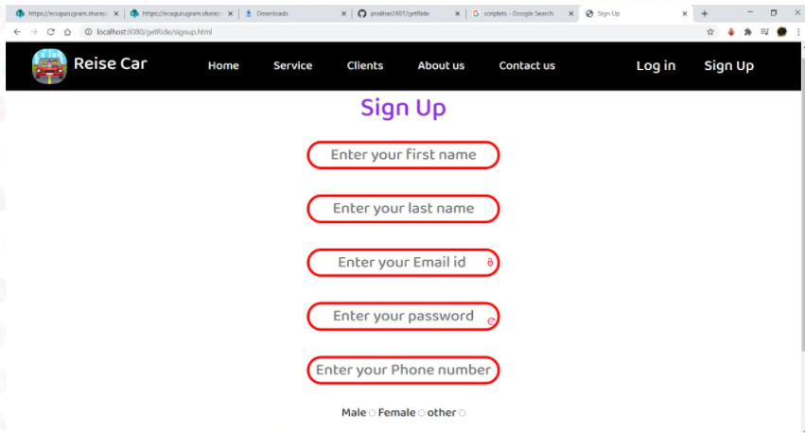

Slide 11
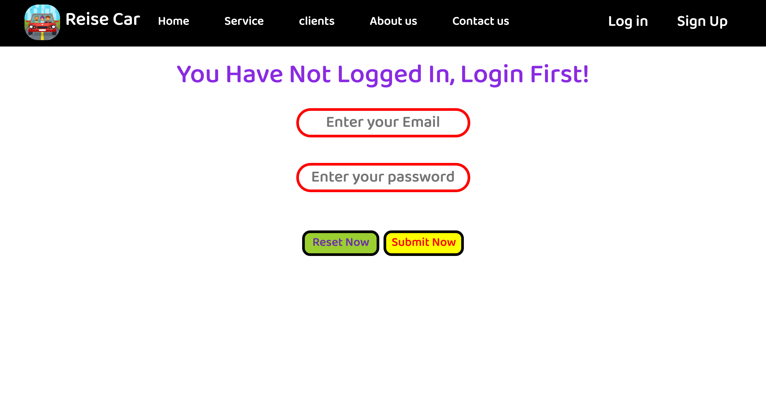
ERROR HANDLING

Slide 12
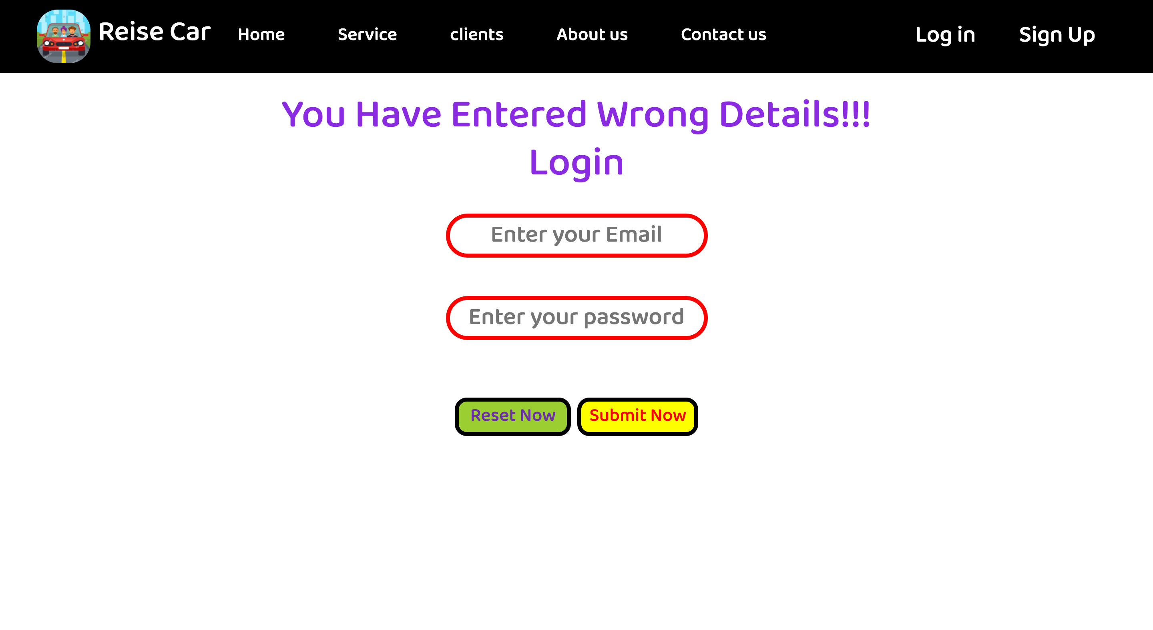

Slide 13
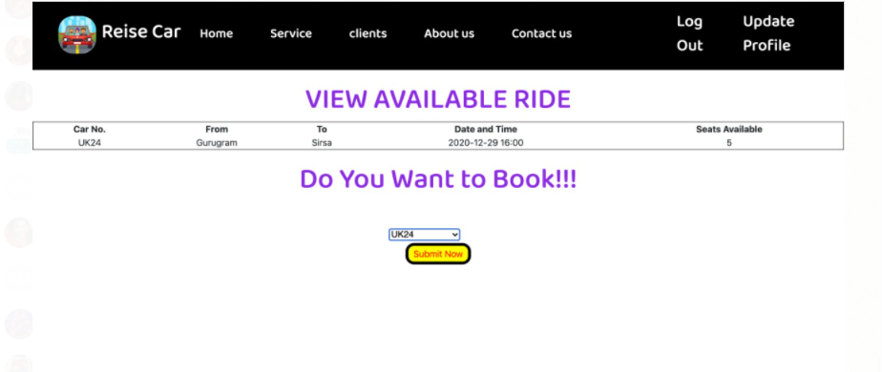

Slide 14
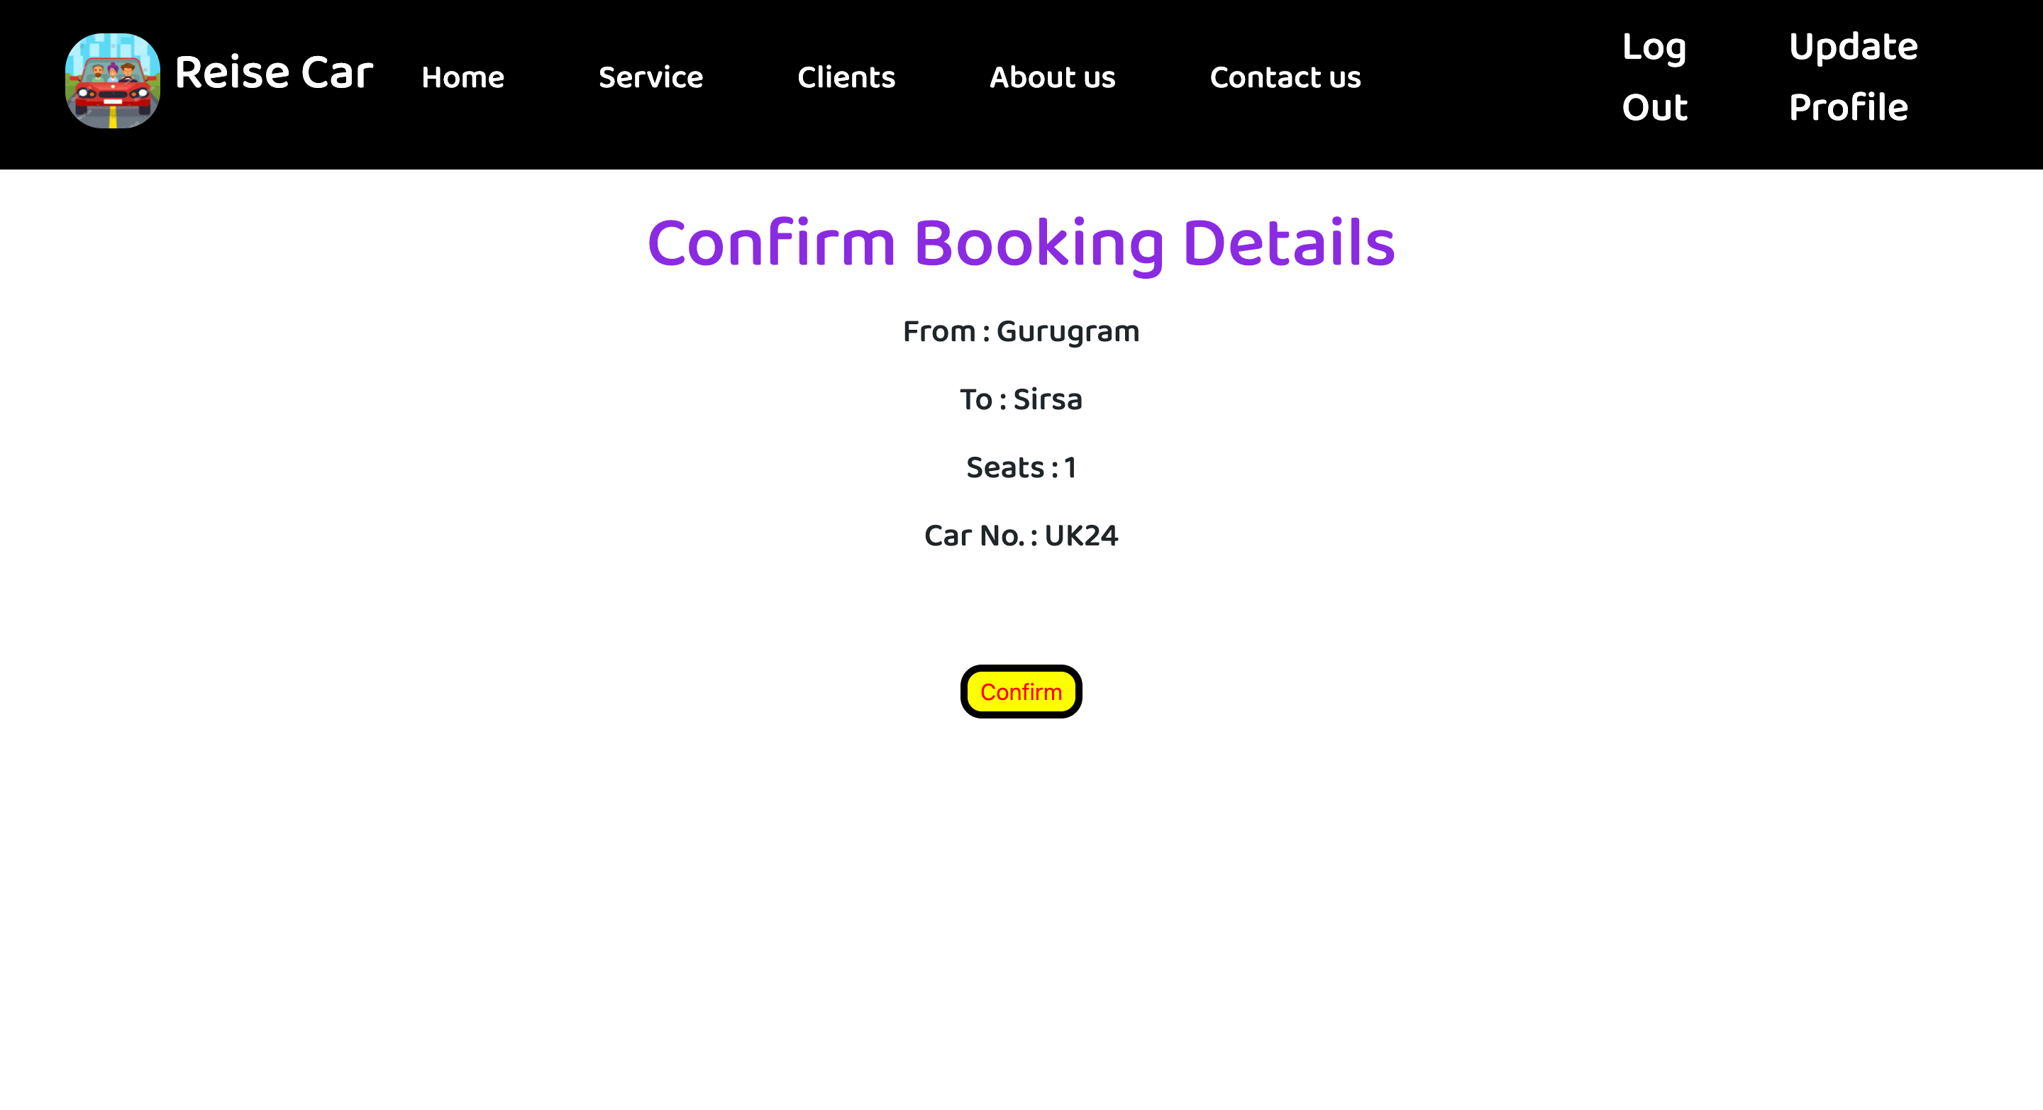
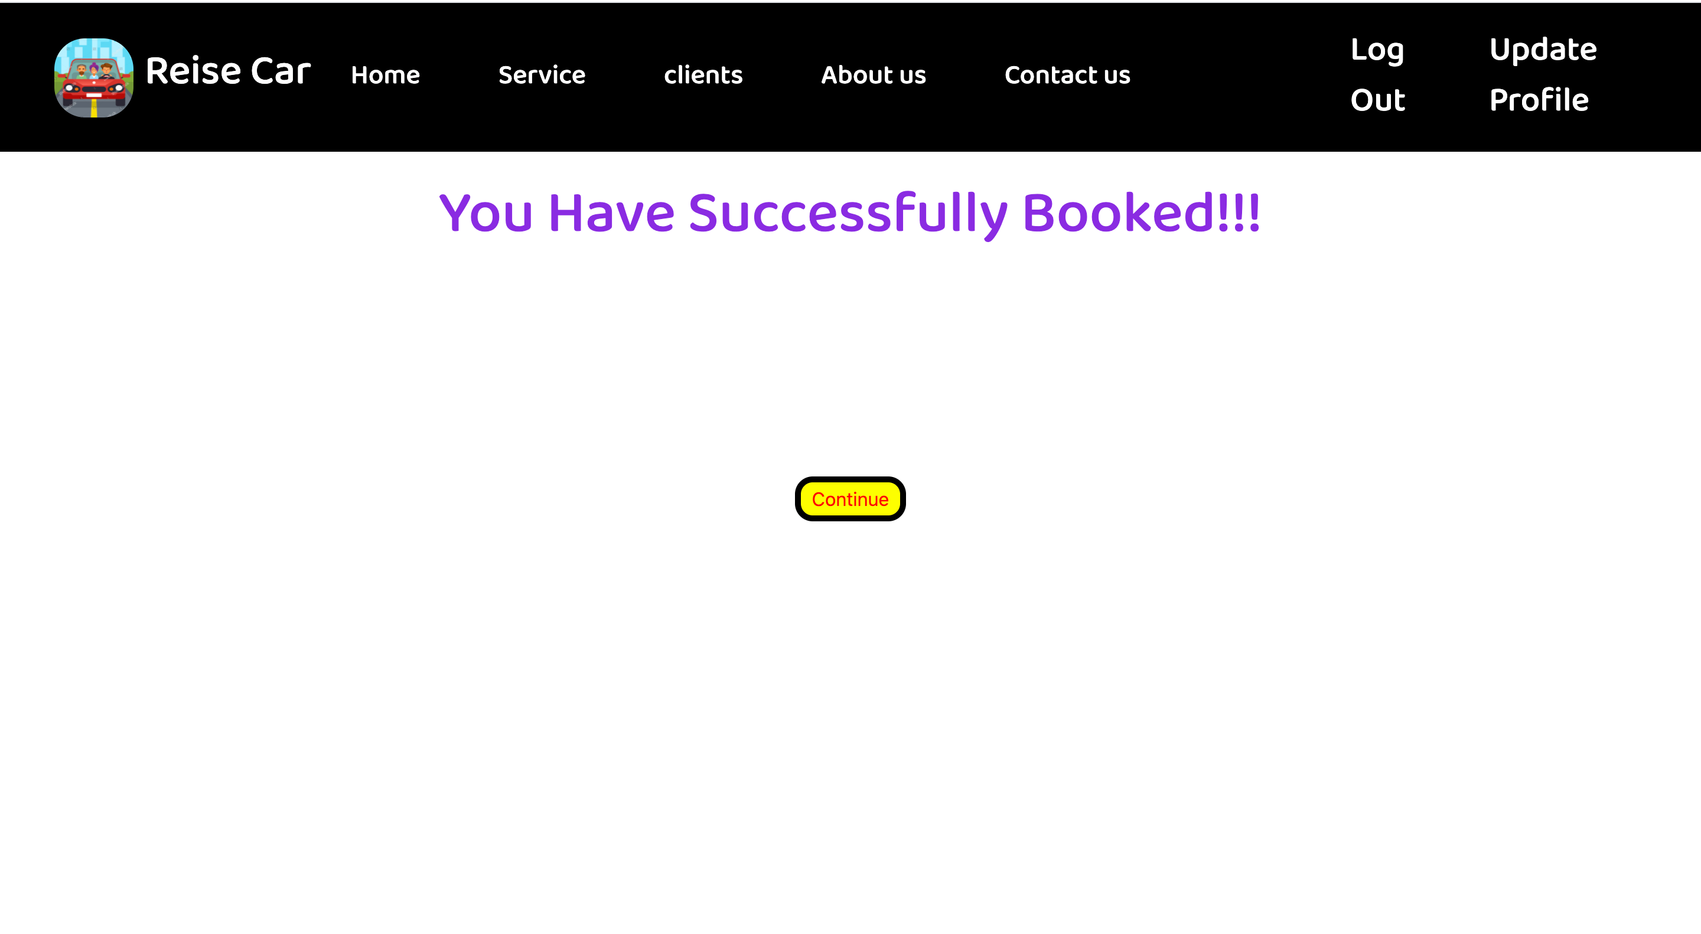

Slide 15
BACK END
JAVA is used for basic functionality of the website at the backend.
MAVEN was used to give our project proper structure.
SERVLET is used here to extend the capabilities of servers that host applications accessed by means of a request-response programming model.
JDBC helped us making connections with database and in defining and manipulating the data in the database.
TOMCAT was used as container in storing our SERVLETS and JSP code.
SQL helped us in managing and organizing our data.

Slide 16
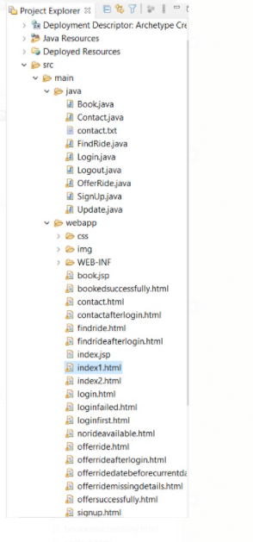
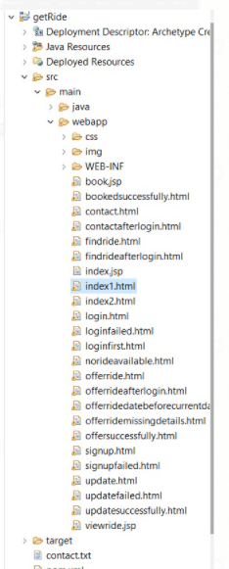
Project Design

Slide 17
Acknowledgment
We , THE MEMBERS OF GROUP 5 , would like to express our sincere thanks to SUMIT KUMAR SIR for HIS valuable guidance and support in completing our project.
APART FROM THIS WE WOULD ALSO LIKE TO EXPRESS OUR GRATITUDE TOWARDS THE EXTERNALS FOR PROVIDING THEIR VALUABLE TIME TO ANALYZING OUR PROJECT.

Slide 18
Thank You

